Slide 1

6th Grade Accelerated Math
Unit 8, Lesson 6 Finding Surface Area and Volume Volume 2, pg. 31

Slide 2


Benchmarks
MA.6.GR.2.4
Given a mathematical or real-world context, find the surface area of right rectangular prisms and right rectangular pyramids using the figure’s net.
MA.6.GR.2.3
Solve mathematical and real-world problems involving the volume of right rectangular prisms with positive rational number edge lengths using a visual model and a formula.
volume 2, pg. 31

Slide 3
Integrated Mathematical Thinking and Reasoning Standards
MA.K12.MTR.1.1 Actively participate in effortful learning both individually and collectively.
MA.K12.MTR.2.1 Demonstrate understanding by representing problems in multiple ways.
MA.K12.MTR.4.1 Engage in discussions that reflect on the mathematical thinking of self and others.
MA.K12.MTR.5.1 Use patterns and structure to help understand and connect mathematical concepts.
MA.K12.MTR.7.1 Apply mathematics to real-world contexts.
volume 2, pg. 31

Slide 4

Learning Targets
I can find the surface area of right rectangular prisms and right rectangular pyramids.
I can find the volume of right rectangular prisms.
volume 2, pg. 31

Slide 5

Warm-Up
volume 2, pg. 32

Slide 6
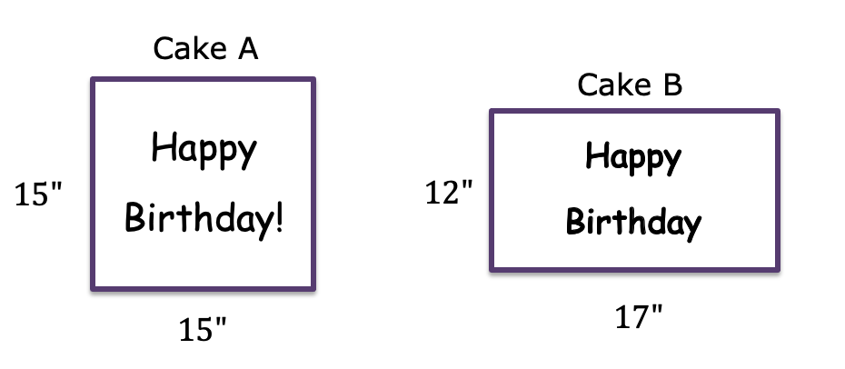
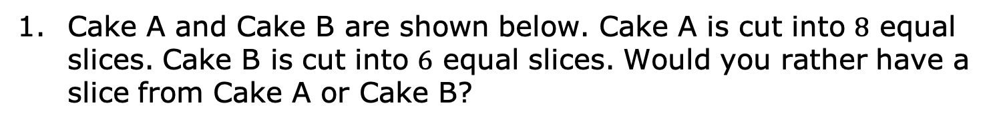
8.6.1 Warm-Up: Would You Rather?
Cake A and Cake B are shown below. Cake A is cut into $8$ equal slices. Cake B is cut into $6$ equal slices. Would you rather have a slice from Cake A or Cake B?
volume 2, pg. 32

Slide 7

Collaboration
volume 2, pg. 32

Slide 8

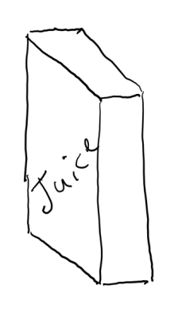



8.6.2 Collaboration: Which Juice Box is Better?
Julius is designing a juice box. He drew a model of his box.
If the juice box has a volume of $196.875$ cubic centimeters (cm³), what is the width of the box?
$10.5$ cm
$5$ cm
?
volume 2, pg. 32

Slide 9
How much packaging board would Julius need to make a juice box with these dimensions, not taking into consideration any overlap of the faces?
volume 2, pg. 33

Slide 10
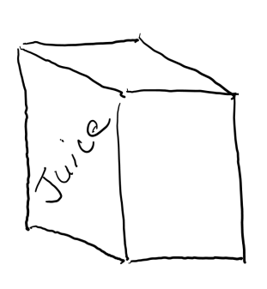


Julius wondered how the juice box would be affected if he changed the dimensions, but kept the volume the same.
What is the new length?
How much packaging board would Julius need to make the new juice box?
$7.5$ cm
?
$5$ cm
volume 2, pg. 33

Slide 11
If Julius wants to use the least amount of material to construct the juice box, which juice box should he choose? Explain your reasoning.
volume 2, pg. 33

Slide 12

Guided Practice
volume 2, pg. 34

Slide 13

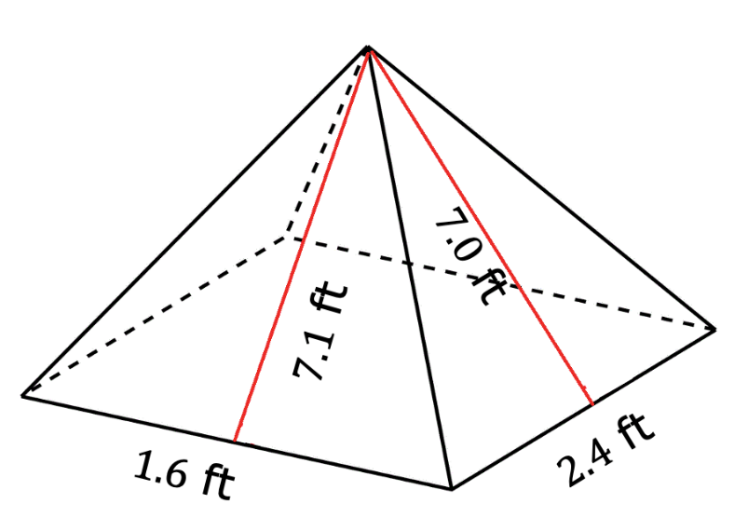
8.6.3 Guided Practice: Surface Area and Volume
With your partner, complete the chart for the three-dimensional figures below.
volume 2, pg. 34

Slide 14

What is the type of figure?
Draw a net or the individual faces of the figure. Label the measurements.
Find the surface area of the figure.
volume 2, pg. 34

Slide 15
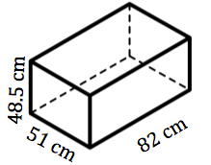
What is the type of figure?
Draw a net of the figure or the individual faces. Label the measurements.
Find the surface area of the figure.
Find the volume of the figure.
volume 2, pg. 35

Slide 16

Your Turn
volume 2, pg. 35

Slide 17
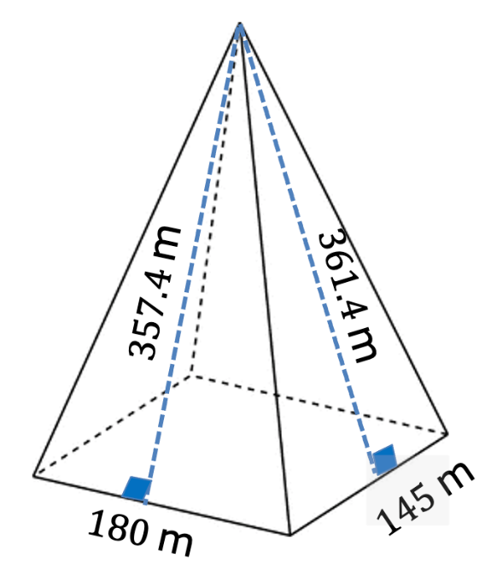
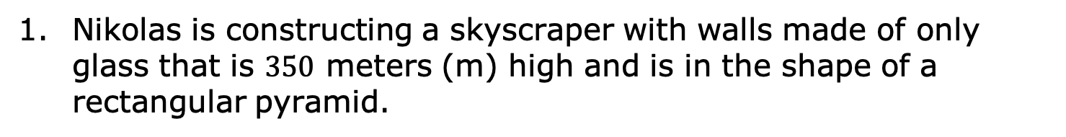
8.6.4 Your Turn!
Nikolas is constructing a skyscraper with walls made of only glass that is $350$ meters (m) high and is in the shape of a rectangular pyramid.
volume 2, pg. 35

Slide 18

What is the surface area of the skyscraper?
Using the model shown, determine how much of the surface area will be made of glass.
volume 2, pg. 35

Slide 19
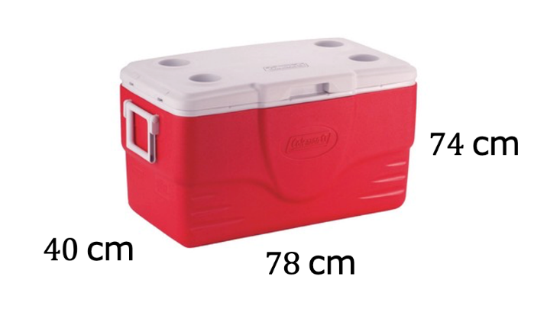

A cooler has a length of $78$ centimeters (cm), a height of $74$ cm, and a width of $40$ cm.
Find the surface area of the cooler.
Find the volume of the cooler.
volume 2, pg. 36

Slide 20
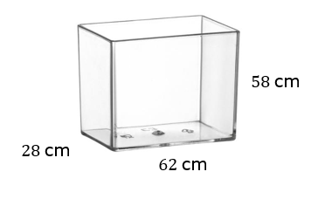
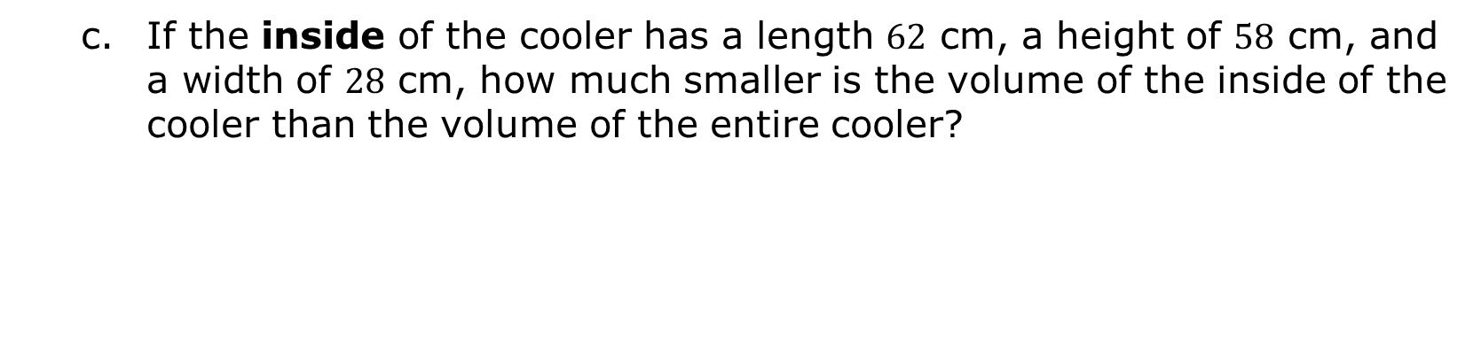
If the inside of the cooler has a length $62$ cm, a height of $58$ cm, and a width of $28$ cm, how much smaller is the volume of the inside of the cooler than the volume of the entire cooler?
volume 2, pg. 36

Slide 21
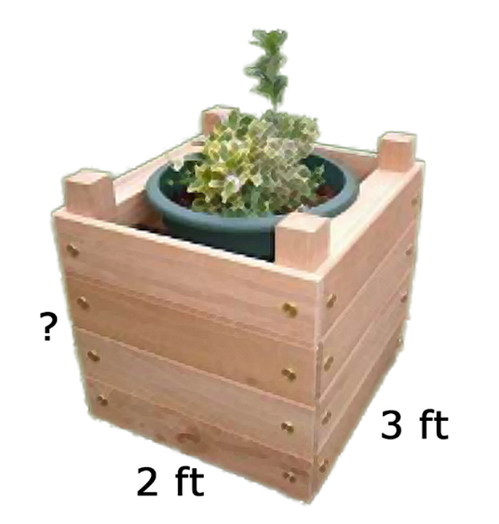
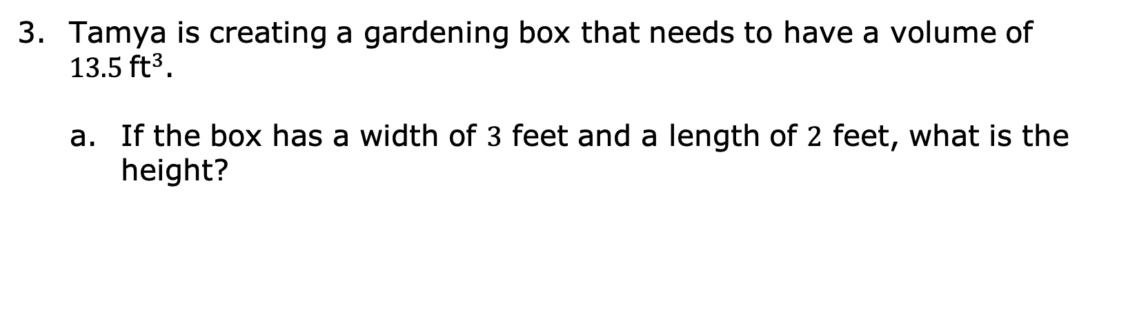
Tamya is creating a gardening box that needs to have a volume of $13.5 {\text{ft}}^{3}$.
If the box has a width of 3 feet and a length of $2$ feet, what is the height?
volume 2, pg. 36

Slide 22
Tamya decided to paint the exterior walls of the gardening box and needs to know how much paint to buy. What is the surface area of the area she wants to paint?
volume 2, pg. 36

Slide 23
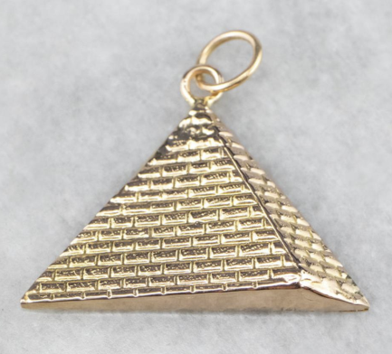


Ryan makes custom jewelry and recently received an order for a pendant in the shape of a rectangular pyramid. Ryan designed a hollow gold pendant to have a square base with a side length of 15 millimeters (mm) and a slant height of 13.24 mm.
How much gold does Ryan need to make the pendant?
$13.24$mm
$15$mm
volume 2, pg. 37

Slide 24

Wrap-Up
volume 2, pg. 37

Slide 25
8.6.5 Wrap-Up: Reflection
Rate yourself on each of the concepts.
4 – I can do this on my own.
3 – I can do this but need more practice.
2 – I need help getting started.
1 – I do not understand yet.
Concept | Rating
I can find the surface area of a right rectangular pyramid using a net or the figure. | 1 2 3 4
I can find the surface area of a right rectangular prism using a net or the figure. | 1 2 3 4
I can find the volume of a right rectangular prism. | 1 2 3 4
volume 2, pg. 37

Slide 26
A barrier to my learning today was …
I will try to overcome this by …
volume 2, pg. 37

